Slide 1
How to use APEX Oracle

Slide 2
Go to the following site
https://apex.oracle.com/en/learn/getting-started/

Slide 3
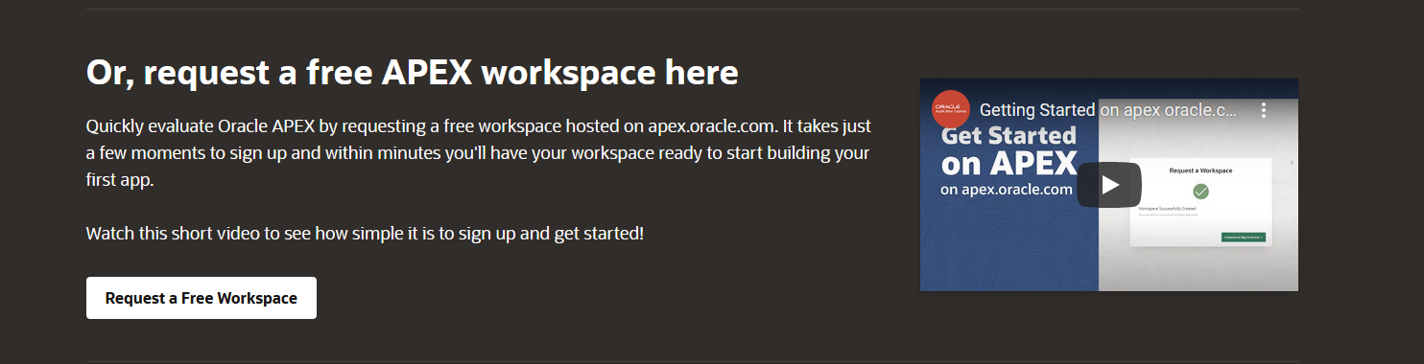
Click request for a work space

Slide 4
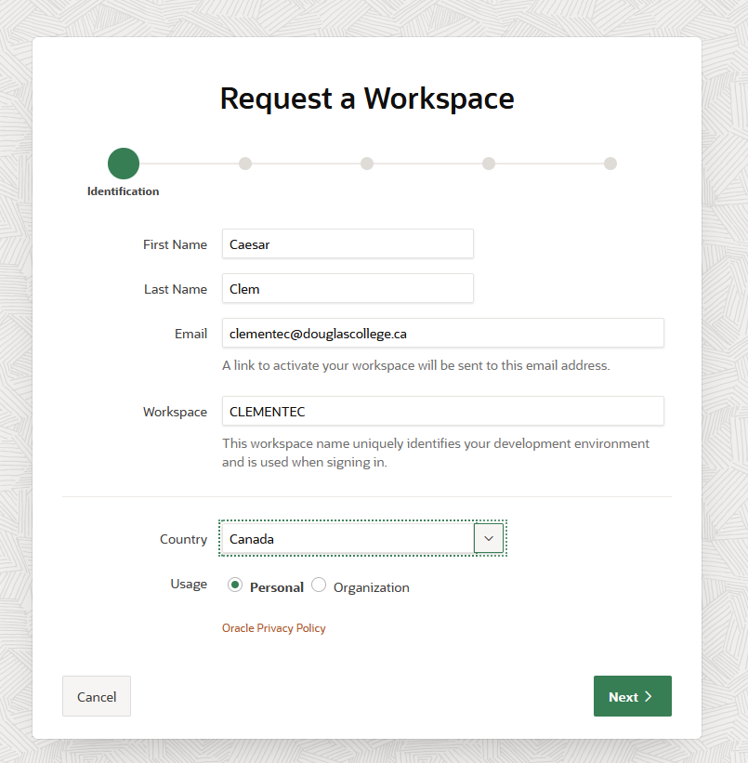
Fill up the details. Do not forget to take a picture so you will remember you workspace name

Slide 5
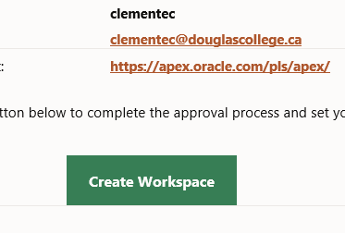
Open email and click workspace create workspace

Slide 6
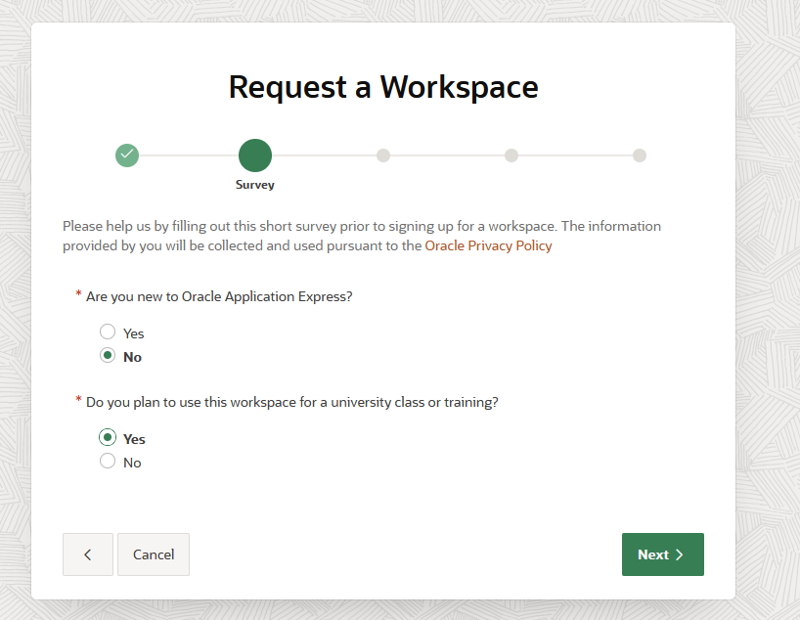
Answer the survey

Slide 7
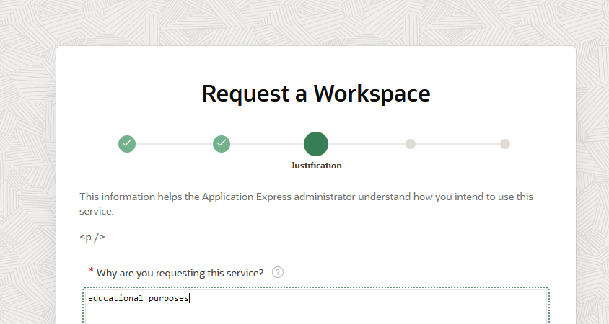
Provide a purpose

Slide 8
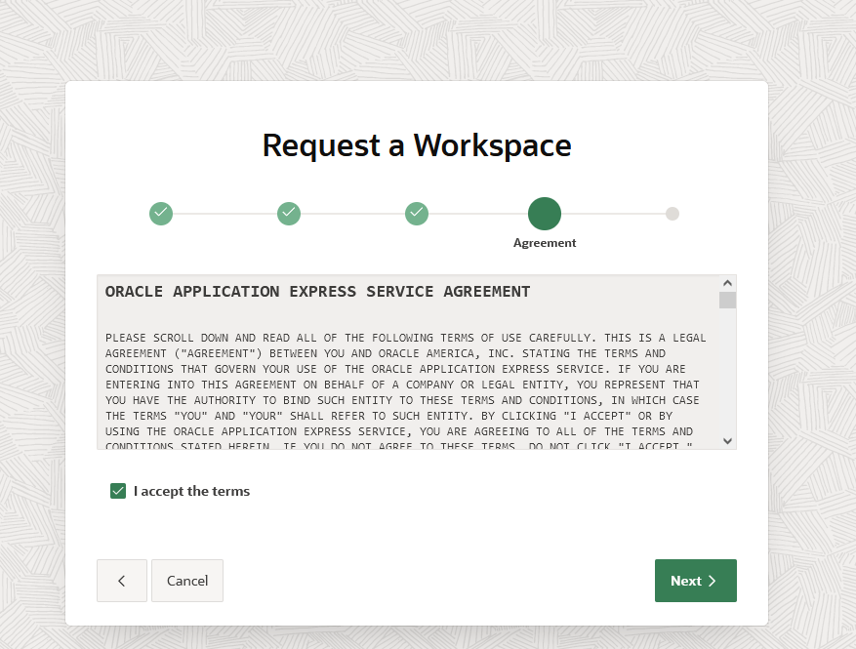
Accept the terms

Slide 9
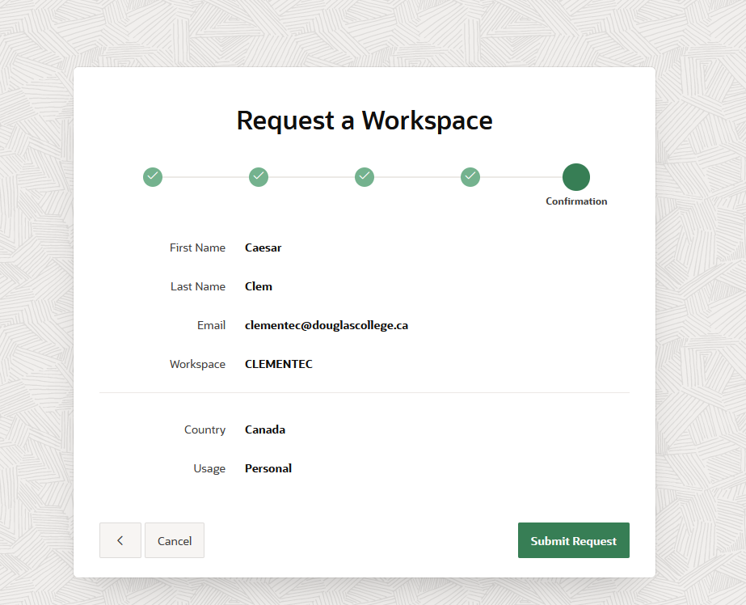
Submit Request

Slide 10
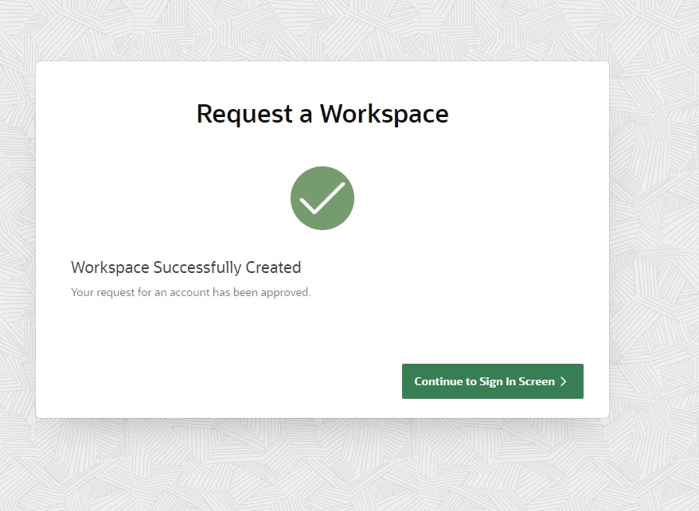
Click continue to sign in screen

Slide 11
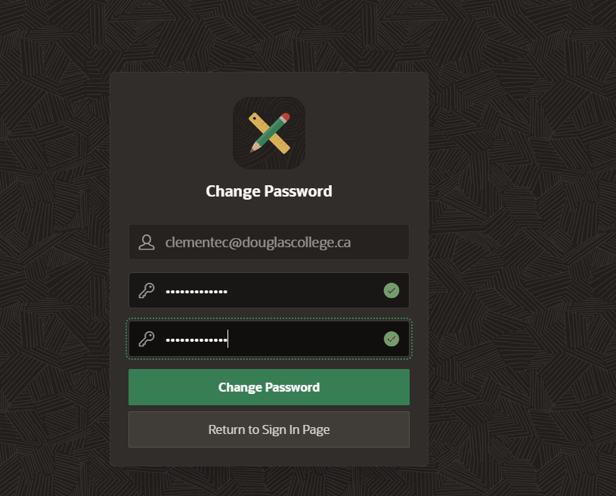
Change password

Slide 12
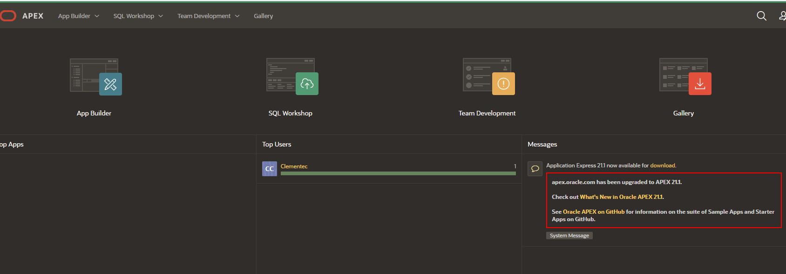
Now you are ready

